Slide 1
SEC285: Fundamentals of information security
Created by: Jeremy Duncan
December 13th 2021

Slide 2
Introduction
In this project I will be demonstrating fundamental concepts of information security.

Slide 3
Concepts Covered
Section 1: Asymmetric Key Encryption
Section 2: Stateful Firewalls
Section 3: Security Policies
Section 4: Multifactor Authentication (MFA)
Section 5: Vulnerability Assessments

Slide 4
SECTION 1
Asymmetric key encryption:
In section one of my project, I am:
Using technical and administrative controls using asymmetric key encryption using kali linux.
implement asymmetric key encryption using GPG.
permanently delete files using the shred command.

Slide 5
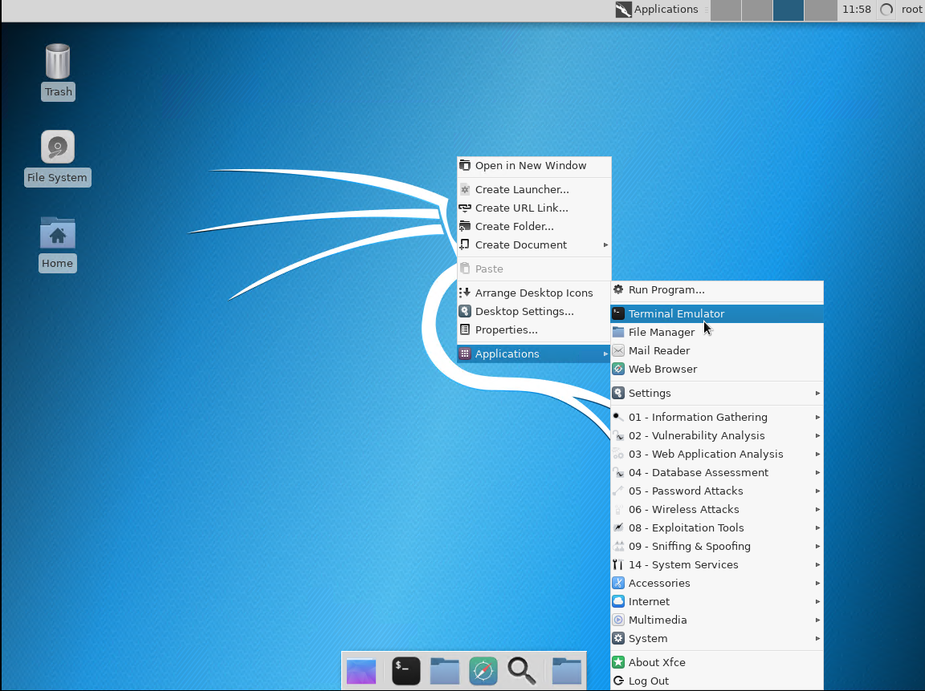
Section 1: Asymmetric Key Encryption
I will be using Kali Linux for this demonstration.
Once Kali Linux has loaded up, I open the terminal.

Slide 6
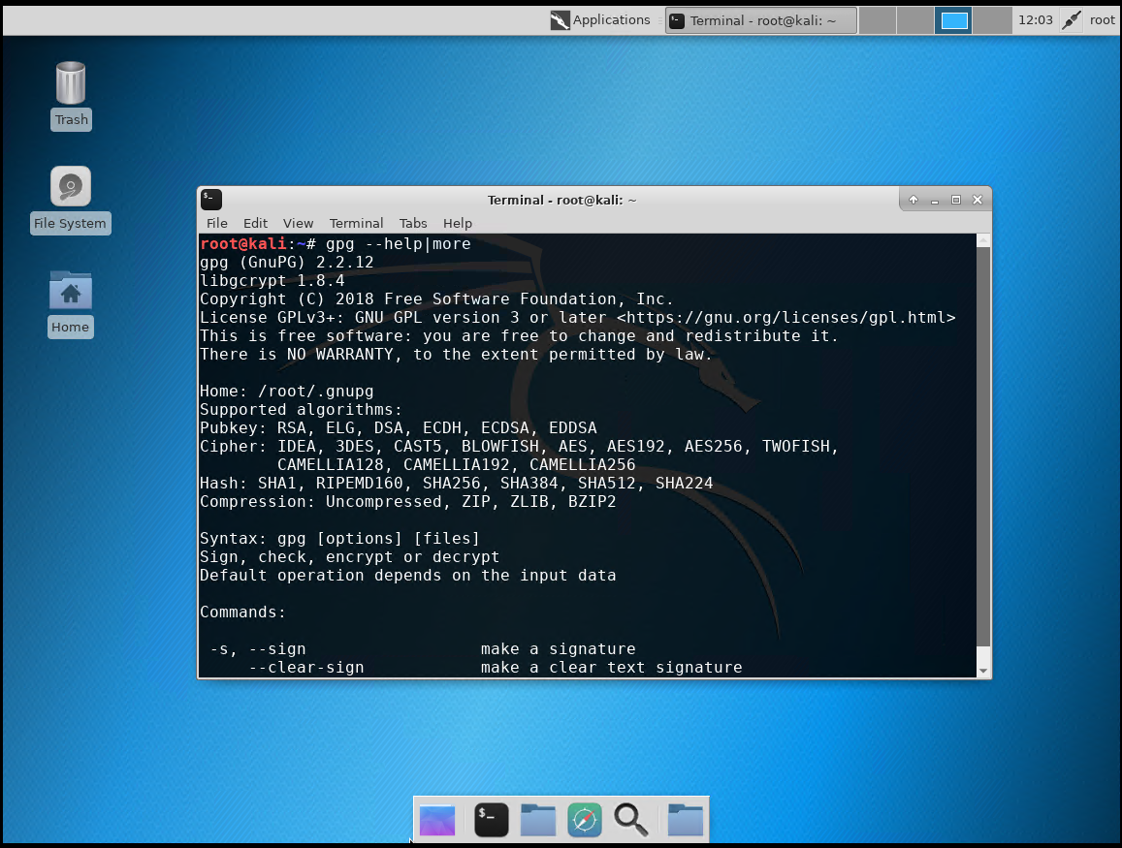
Section 1: Asymmetric Key Encryption
I’ll be using GNU Privacy Guard (GPG) which is an asymmetric encryption standard.
I type in gpg - -help|more to pull up information on the GPG command.

Slide 7
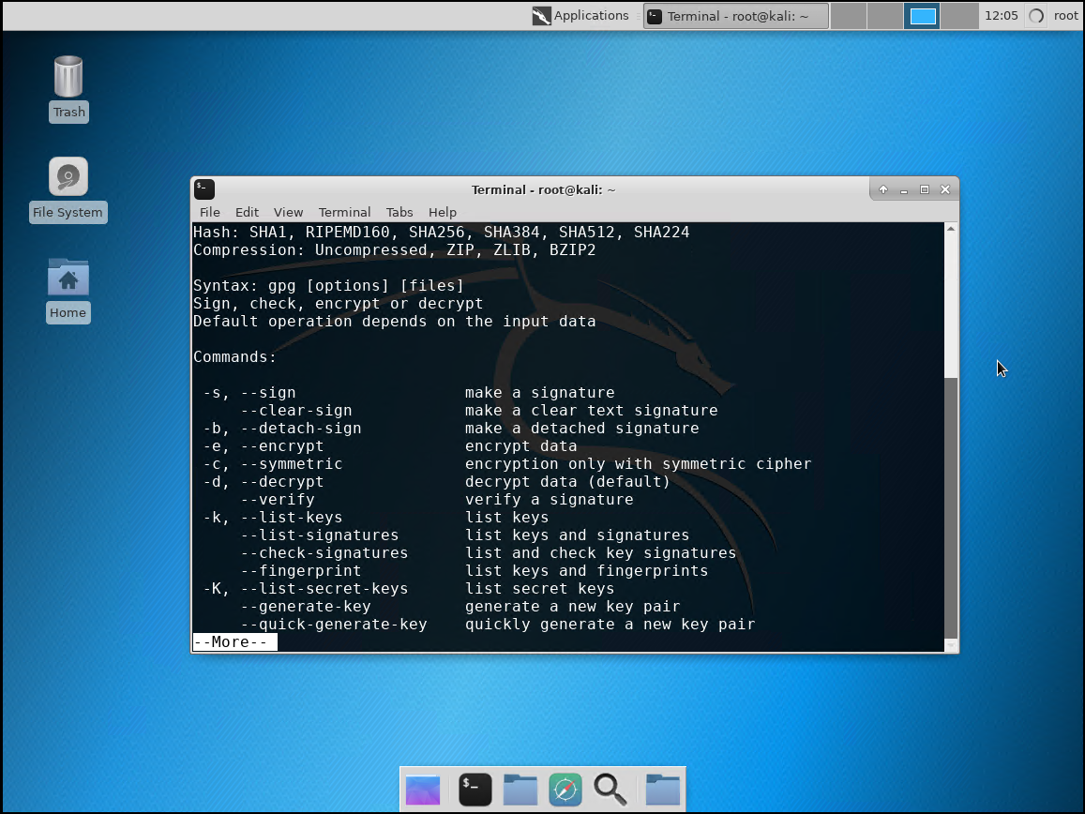
Section 1: Asymmetric Key Encryption
You can see all the available commands for GPG.

Slide 8
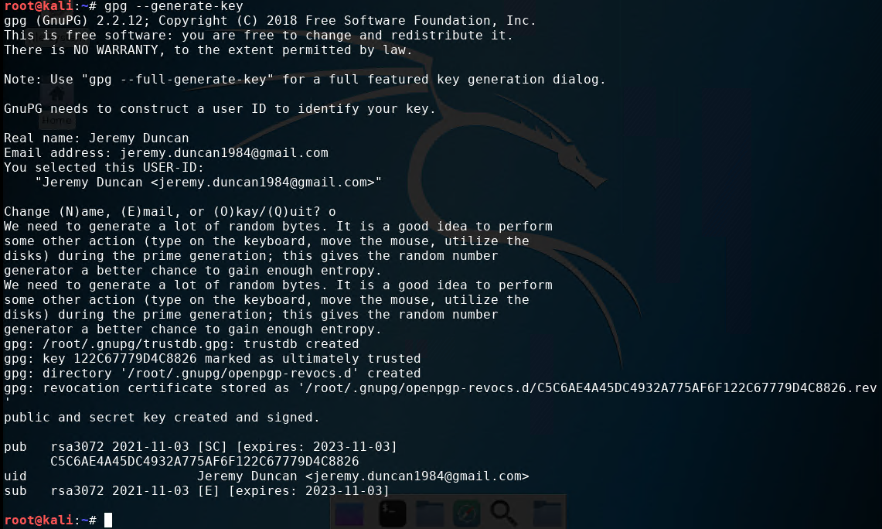
Section 1: Asymmetric Key Encryption
The GPG command I’ll be using is - -generate-key to create a public and private key for my encryption needs.

Slide 9
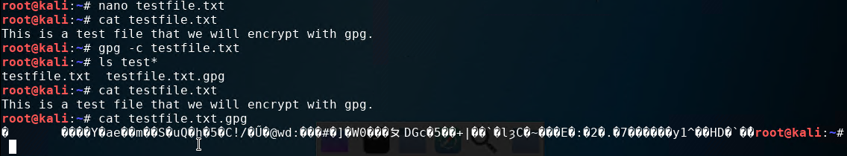
Section 1: Asymmetric Key Encryption
Next, I create text file called “testfile.txt and write a small message inside it.
I then encrypt it using GPG.
I type in ls test* to list the files that contain the words test and I can see my original text file, and another one with GPG encryption.
I can still open the original text file and read it, but if I try to open the encrypted text file it is unreadable as shown.

Slide 10
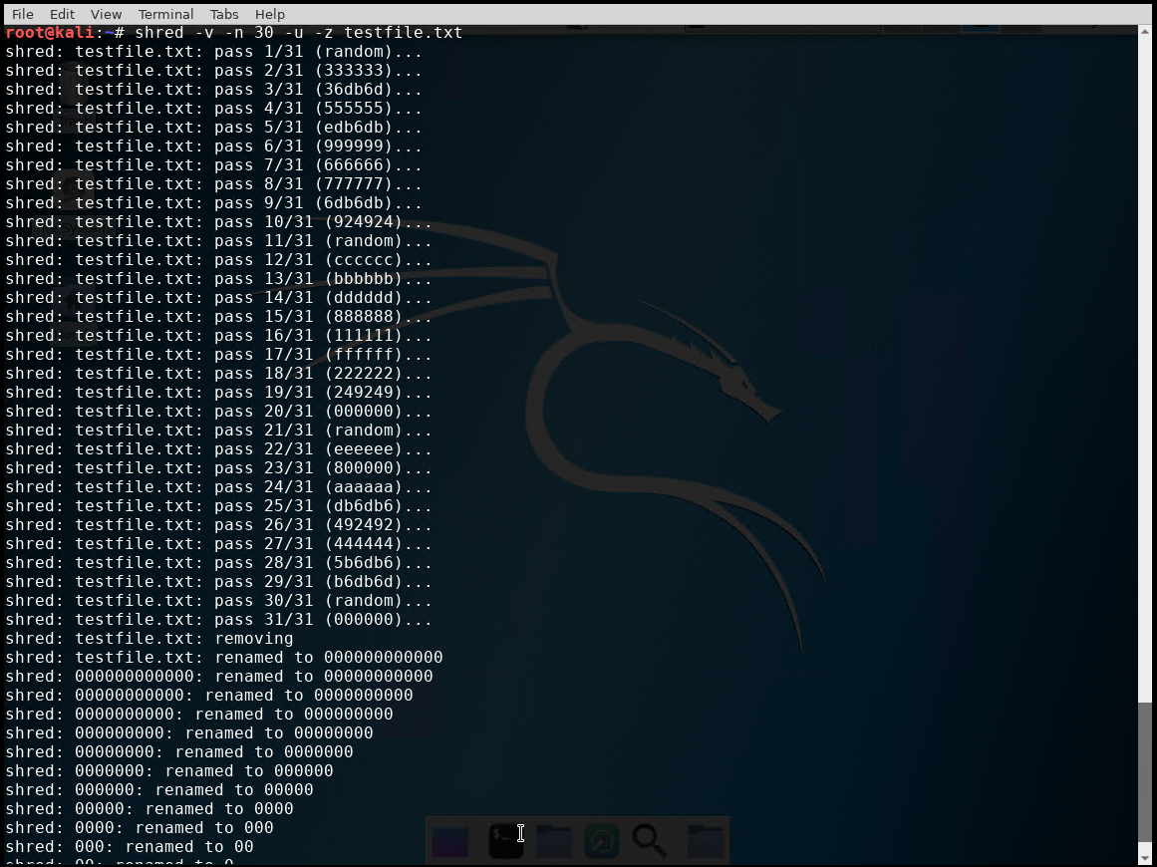
Section 1: Asymmetric Key Encryption
If I want to make my text file completely secure, I must securely delete the unencrypted file.
I use the shred command to securely delete my file testfile.txt.

Slide 11
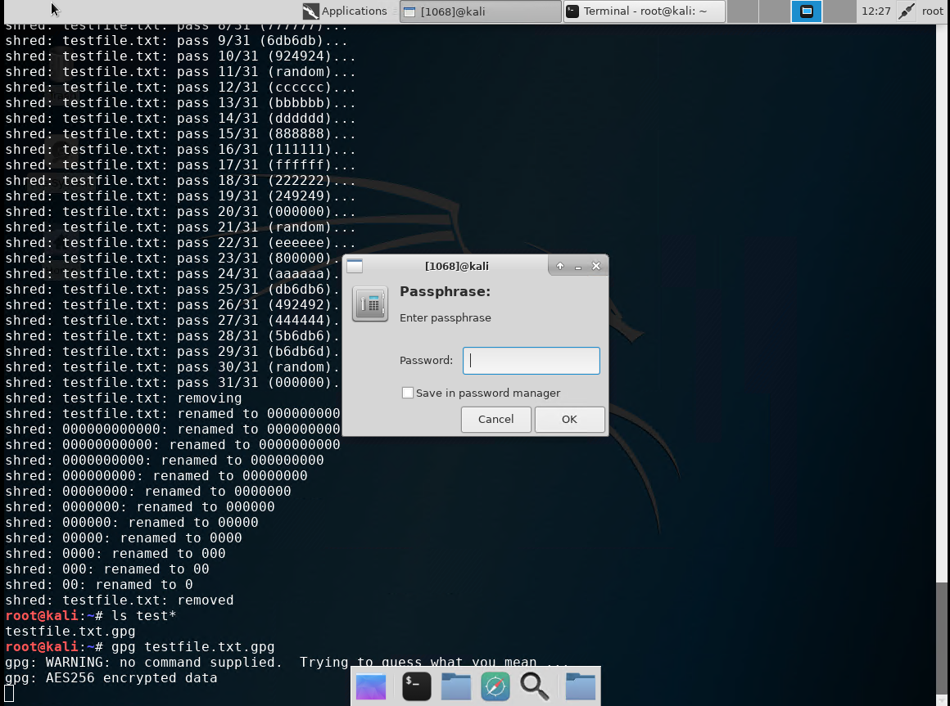
Section 1: Asymmetric Key Encryption
Once deleted I verify by showing the list of files with test.
I open the encrypted file with GPG and enter the passphrase to decrypt the file to view the contents.

Slide 12
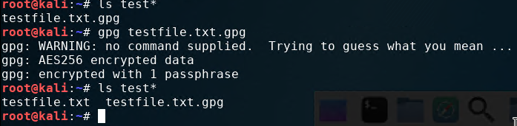
Section 1: Asymmetric Key Encryption
Once decrypted, testfile.txt is shown in the directory along with testfile.txt.gpg again.

Slide 13
SECTION 2
Stateful firewalls:
In section two of my project, I am:
Demonstrating how a firewall is used to protect enterprise computing resources from attacks.
harden a Linux server by setting up a stateful firewall with iptables.

Slide 14
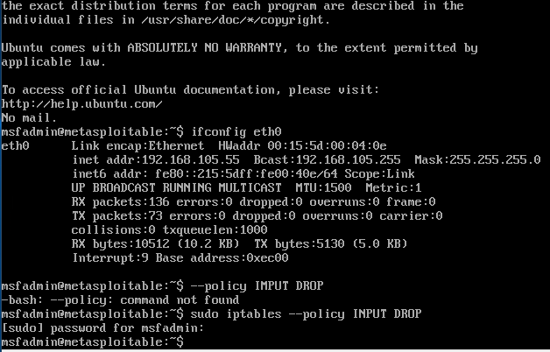
Section 2: Stateful Firewalls
To find the IP information on my linux server I type in ifconfig eth0.
Next I modify the iptables policy.

Slide 15
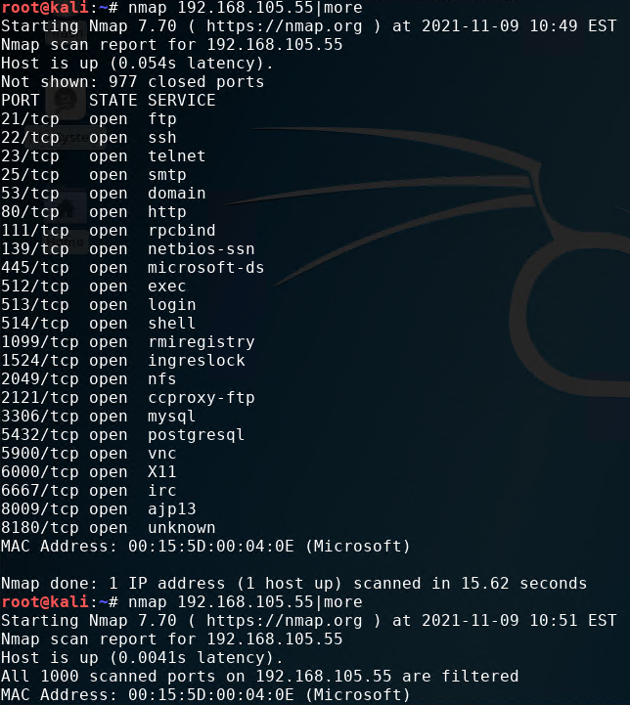
Question
Section 2: Stateful Firewalls
What effect does the sudo iptables --policy INPUT DROP command have on the access to computing resources?
Answer: It filters the ports so someone on the outside cannot detect what ports are open when they do a port scan.
BEFORE “sudo iptables –policy INPUT DROP”
AFTER “sudo iptables –policy INPUT DROP”

Slide 16
Section 2: Stateful Firewalls
The goal is to only allow web (HTTP and HTTPS), email (SMTP), name resolution (DNS), and SSH services, as listed below:
Rule Number | Source IP | Destination IP | Protocol/Service | Decision
1 | Any or 0.0.0.0 | 192.168.105.55 | TCP 80 && 443 | ACCEPT
2 | Any or 0.0.0.0 | 192.168.105.55 | TCP 25 | ACCEPT
3 | Any | 192.168.105.55 | UDP 53 | ACCEPT
4 | Any | 192.168.105.55 | TCP 22 | ACCEPT

Slide 17
Section 2: Stateful Firewalls
I type the following commands at the command prompt of the Linux Server VM to flush the INPUT, OUTPUT, and FORWARD chains:
sudo iptables -F INPUT sudo iptables -F OUTPUT sudo iptables -F FORWARD
I enter sudo iptables -L -- line-numbers command, and make sure that no rules are displayed in the table.
I type the following command to drop all invalid packets to the server:
sudo iptables -A INPUT -m conntrack --ctstate INVALID -j DROP

Slide 18
Section 2: Stateful Firewalls
I type the following command to forward all incoming and outgoing traffic on the loopback interface:
sudo iptables -A INPUT -i lo -j ACCEPT sudo iptables -A OUTPUT -o lo -j ACCEPT
I type the following command to accept all packets that are part of an already established TCP connection:
sudo iptables -A INPUT -m conntrack --ctstate ESTABLISHED,RELATED -j ACCEPT
I type the following command to accept incoming SSH sessions:
sudo iptables -A INPUT -i eth0 -p tcp --dport 22 -j ACCEPT
I type the following command to accept all incoming ICMP packets:
sudo iptables -A INPUT -p icmp -j ACCEPT

Slide 19
Section 2: Stateful Firewalls
Next, I add the following rules to the iptables policy to support the services identified in the policy table:
sudo iptables -I INPUT 6 -p tcp --dport 80 -m state --state NEW -j ACCEPT sudo iptables -I INPUT 7 -p tcp --dport 443 -m state --state NEW -j ACCEPT sudo iptables -I INPUT 8 -p tcp --dport 25 -m state --state NEW -j ACCEPT sudo iptables -I INPUT 9 -p tcp --dport 53 -m state --state NEW -j ACCEPT sudo iptables -I INPUT 10 -p tcp --dport 22 -m state --state NEW -j ACCEPT sudo iptables -I INPUT 11 -p udp --dport 53 -j ACCEPT sudo iptables -P INPUT DROP sudo iptables -P FORWARD DROP

Slide 20
Section 2: Stateful Firewalls
After that, I type the following command to allow locally generated packets to be forwarded:
sudo iptables -P OUTPUT ACCEPT
I want to save the iptables rules so that they will persist after the server reboots by typing:
sudo iptables-save
I want to confirm that all rules are in place in my Linux server by typing in:
sudo iptables -L --line-numbers

Slide 21
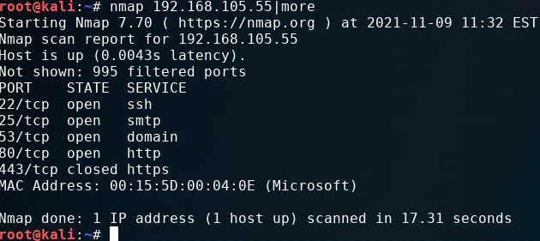
Section 2: Stateful Firewalls
Finally, I want to do another scan to see the results.
As show below, the only ports that are shown available in the scan are the ones that I enabled in the iptables policy.

Slide 22
SECTION 3
Security policies:
In section three of my project, I am:
Demonstrating a bring your own device (BYOD) security policy

Slide 23
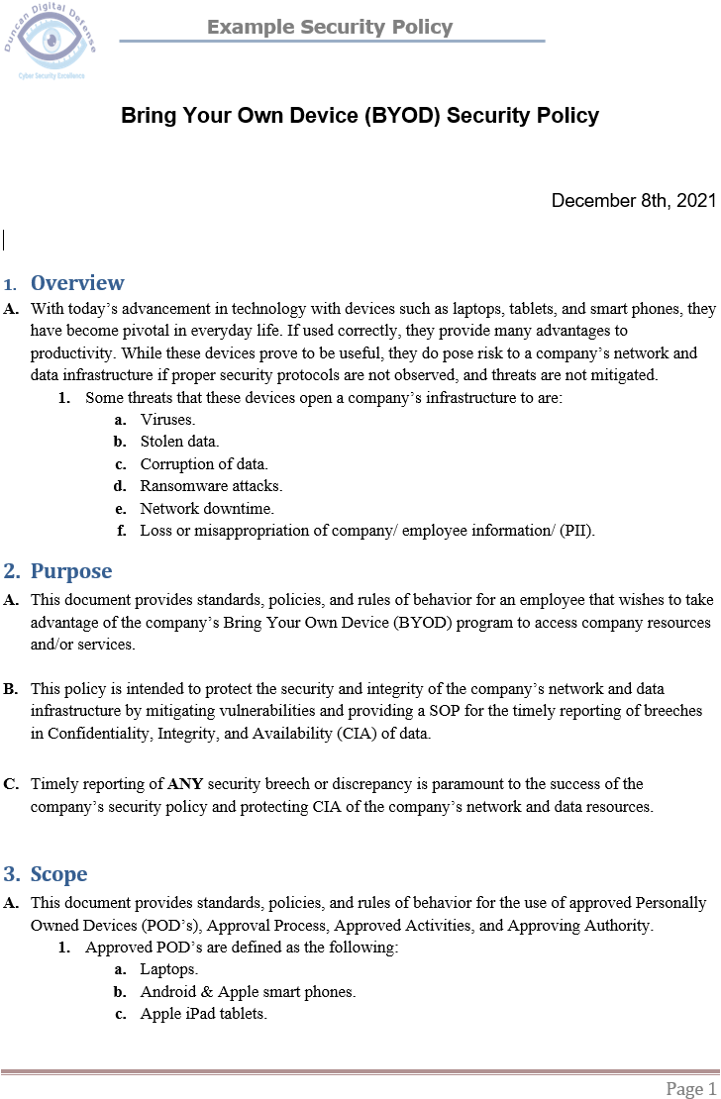
Section 3: Security Policies
The following slides in this section demonstrate an example of a security policy I created.
Security Policy:
Security policies are high-level statements approved by senior management to guide the behavior of people who come into contact with organizational computing resources.

Slide 24
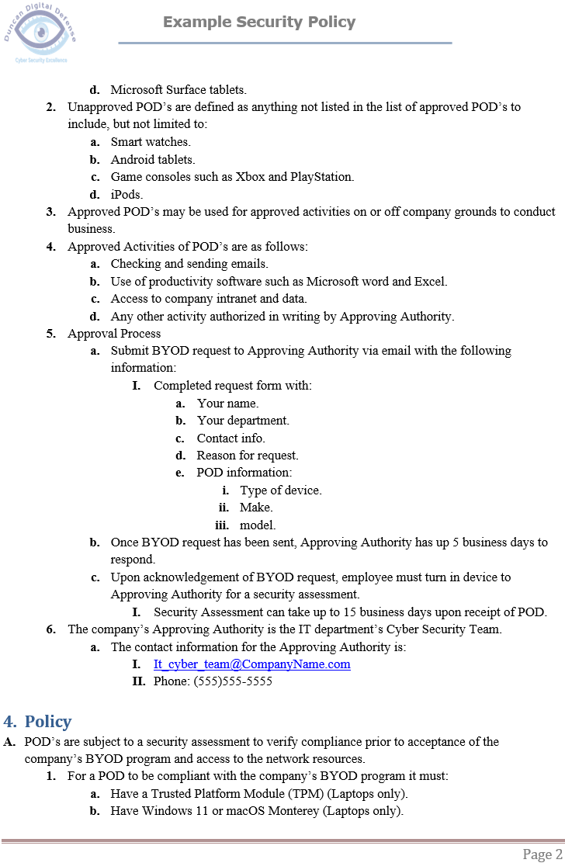
Section 3: Security Policies
A security policy is a set of documents that clarify an organization’s expectations regarding the proper usage of their computing resources.
It specifies which behaviors are considered acceptable and which are not.

Slide 25
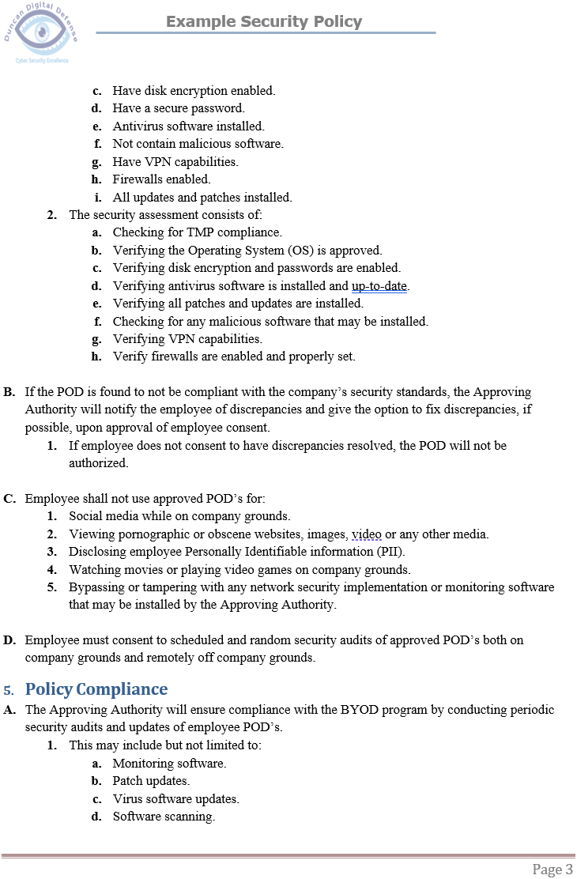
Section 3: Security Policies
It specifies which behaviors are considered acceptable and which are not.
There are three categories of security policies:
Program policy
Issue-specific policy
System-specific policy

Slide 26
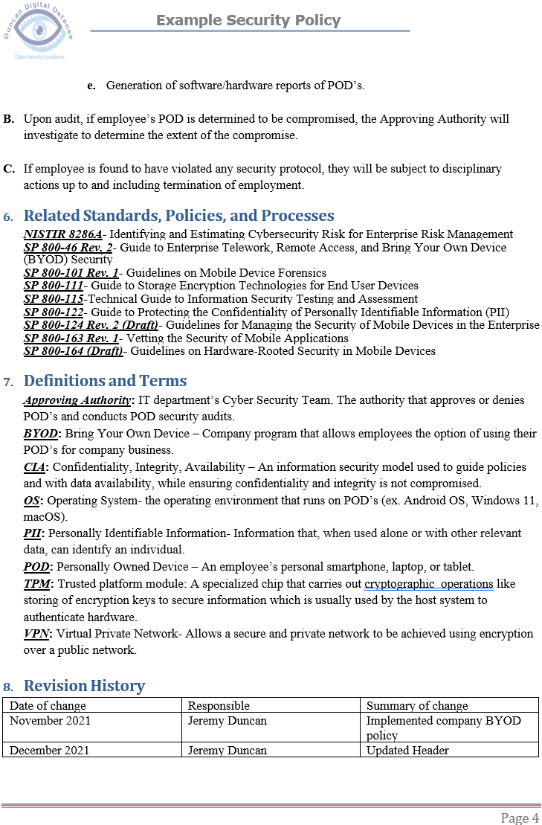
Section 3: security policies
A program policy sets the direction of a security program.
An issue-specific policy focuses on specific technologies implemented in an organization, such as email and virtual private networks (VPNs).
A system-specific policy deals with technologies (similar to an issue-specific policy), as well as addressing security personnel and configurations of the said technologies.

Slide 27
SECTION 4
Multifactor Authentication (MFA):
In section four of my project, I am:
implementing security controls to protect enterprise computing resources, by using multifactor authentication (MFA)
Using a time-based one-time password for the authentication process

Slide 28
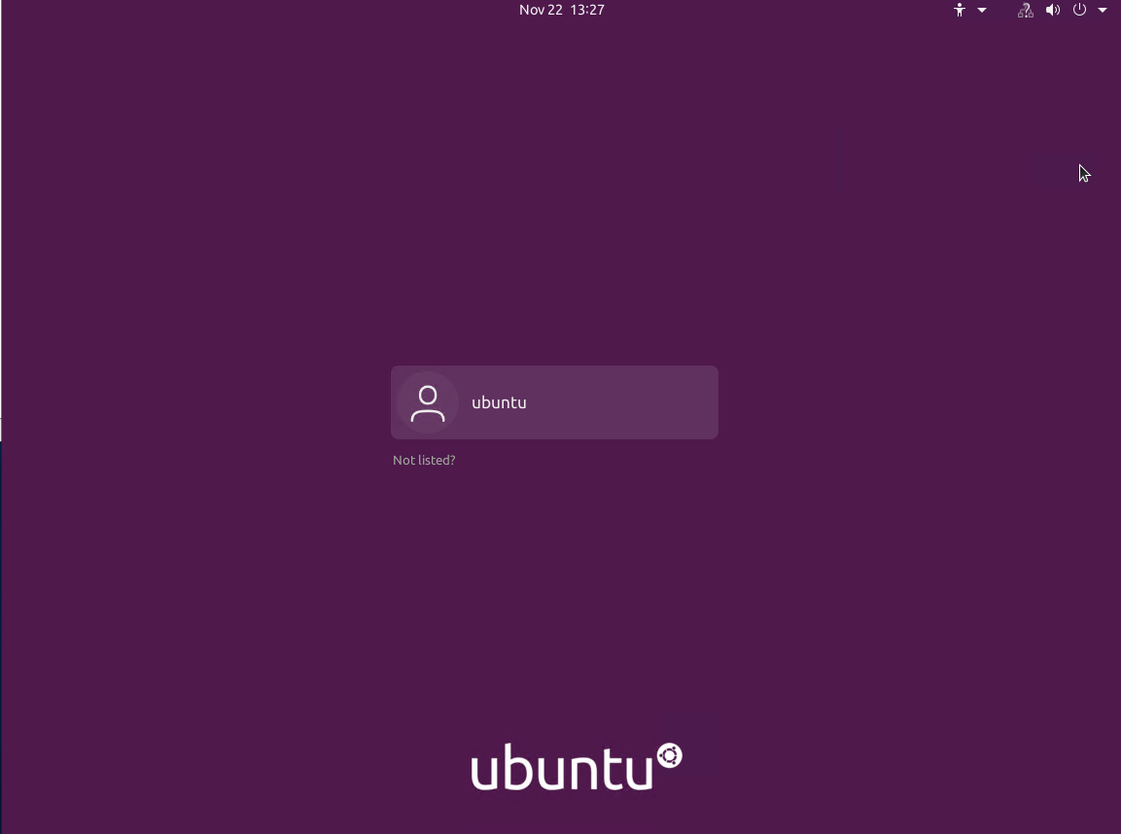
Section 4: Multifactor Authentication (MFA)
Initially in Ubuntu, you just need a password to log into your account.
I’m going to set it up, so you must use a time-based one-time password for the authentication process as well.

Slide 29
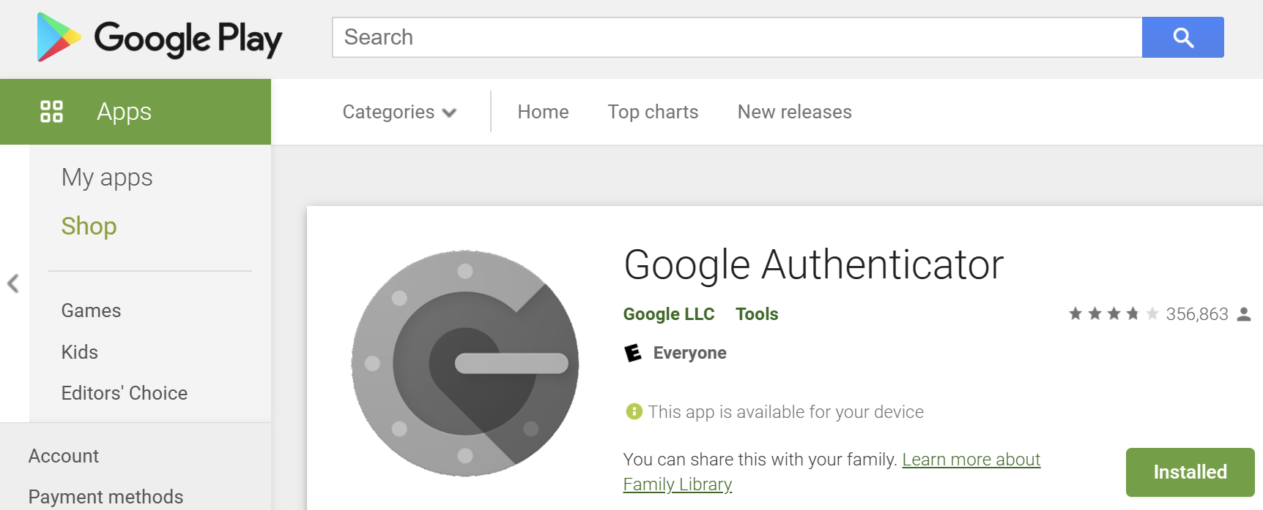
Section 4: Multifactor Authentication (MFA)
The authentication program I will use is Google Authenticator.
It provides real-time time-based passwords that can be used for multi-factor authentication.

Slide 30
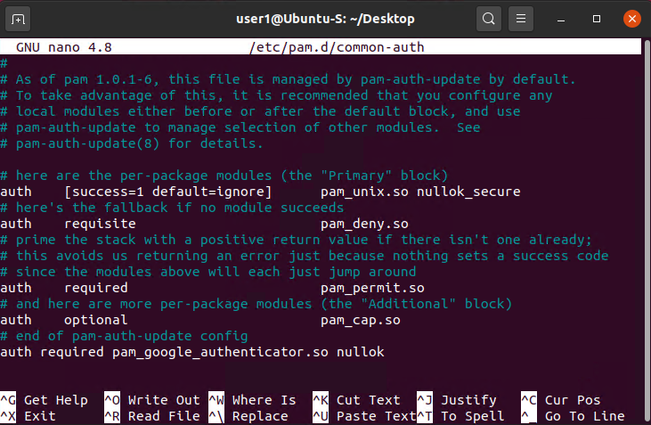
Section 4: Multifactor Authentication (MFA)
Once I login initially, I need to modify the common-auth file.
I need to add the following to the bottom of the file, so Ubuntu requires google authentication:
auth required pam_google_authenticator.so nullok

Slide 31
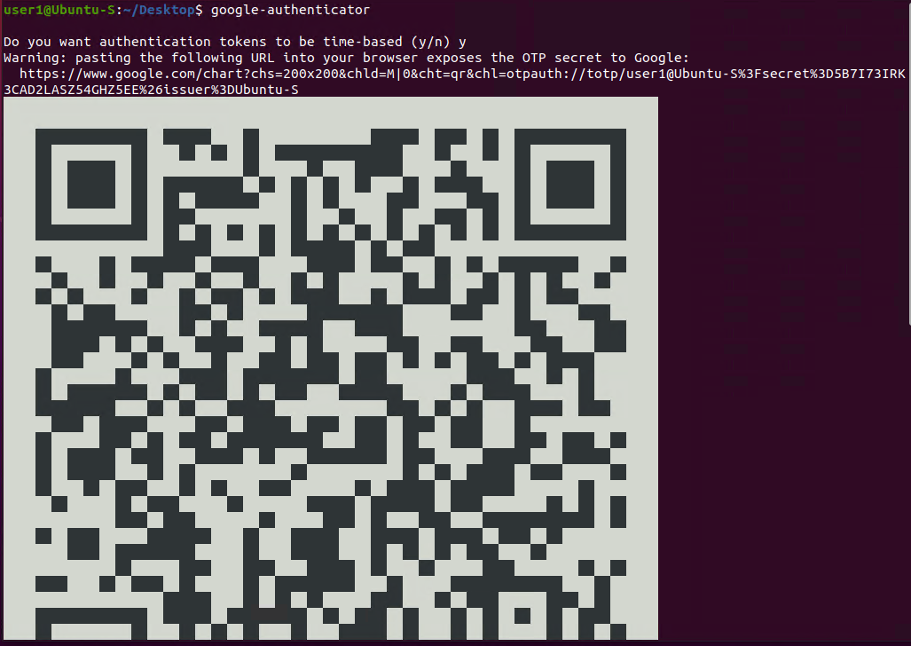
Section 4: Multifactor Authentication (MFA)
Next, I type google-authenticator in the terminal.
I am provided a QR code which I can scan with the Google Authenticator app on my phone.

Slide 32
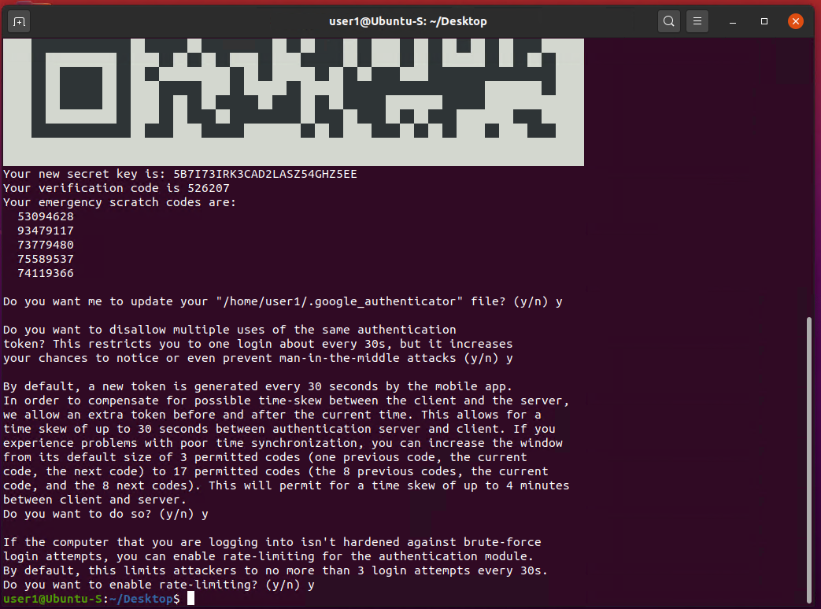
Section 4: Multifactor Authentication (MFA)
It also provides scratch codes that I can manually add to the Authenticator app.

Slide 33
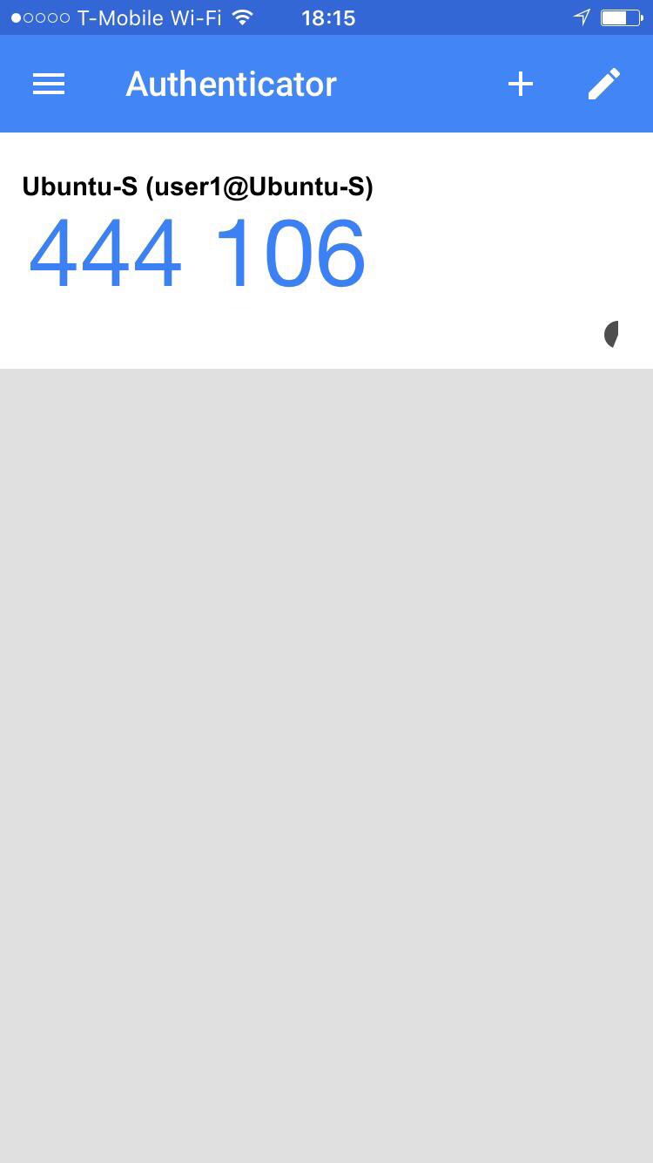
Section 4: Multifactor Authentication (MFA)
Once I scan the QR code, I have my Ubuntu user account added to the authenticator app.
Now I have a Time-Based password that changes every 30 seconds.

Slide 34
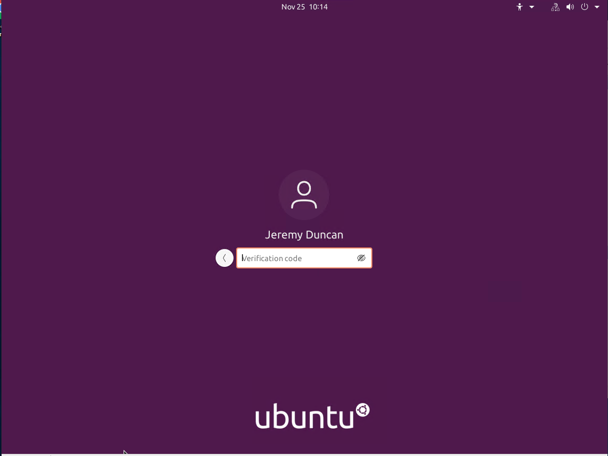
Section 4: Multifactor Authentication (MFA)
Now when I try to login, I am asked to provide an authentication code.
I now have to use the Google Authentication App to retrieve the code every time I log in now.
Once the authentication code has been entered, I then have to enter my password.

Slide 35
SECTION 5
Vulnerability Assessments:
In section five of my project, I am:
Using the following vulnerability assessment tools to assess network security:
Nmap
Wireshark
netcat
Nessus Essentials

Slide 36
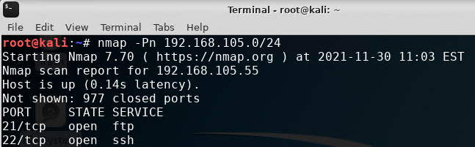
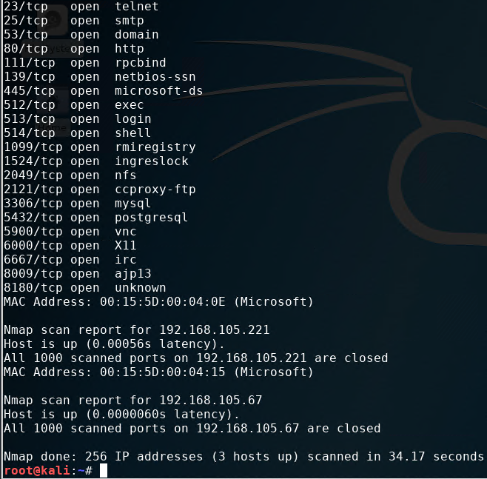
Section 5: Vulnerability Assessments
The NMAP tool can be used to identify IP addresses that are in use on a network segment, assuming that the hosts on the network segment are up and running.
All available IP’s and open ports are displayed when using nmap.

Slide 37
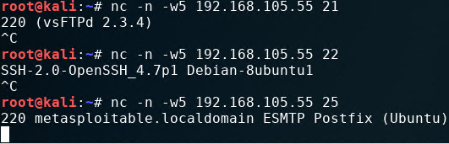
Section 5: Vulnerability Assessments
The NetCat (nc) tool can be used to gain information about FTP, SSH, and SMTP applications that are discovered in an NMAP scan.
This is called Banner Grabbing

Slide 38
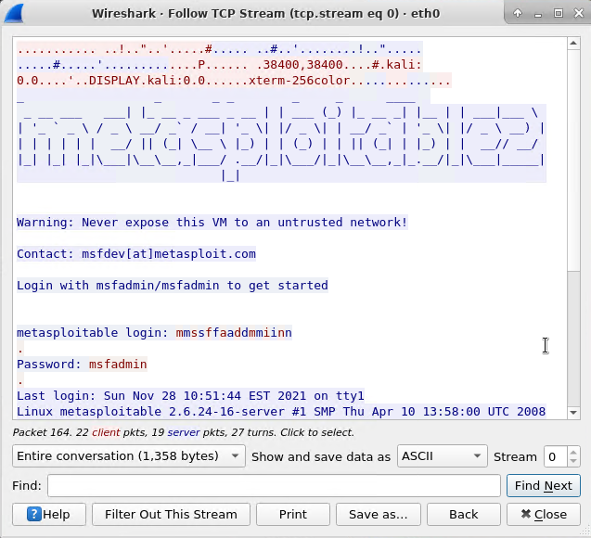
Section 5: Vulnerability Assessments
Wireshark is a packet sniffing tool. It can be used by security practitioners to analyze network traffic and gain insight into client and server applications.
By using Wireshark, I can follow an unsecured tcp stream to my Linux server and view login and password credentials.

Slide 39
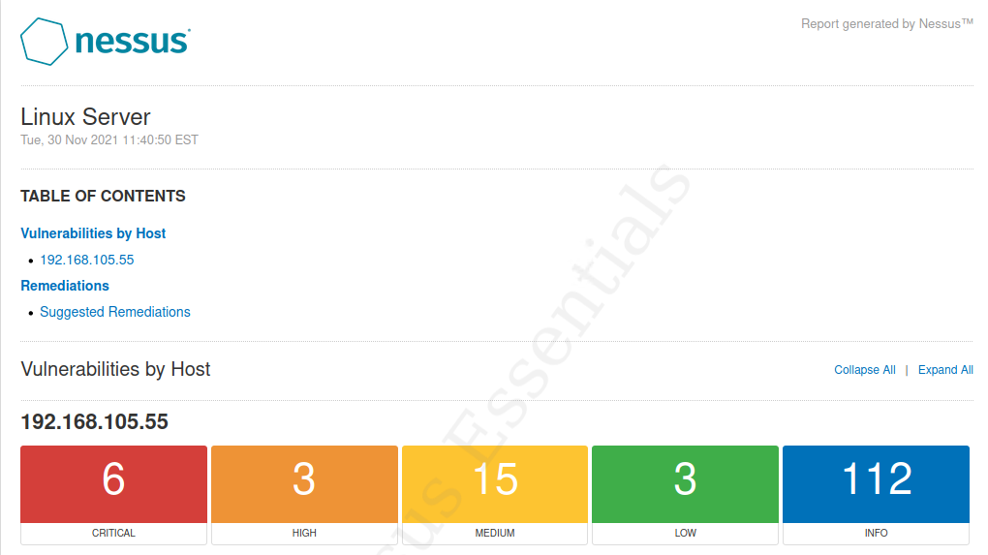
Section 5: Vulnerability Assessments
Nessus Essentials is a free vulnerability scanner that provides an entry point for vulnerability assessment.

Slide 40
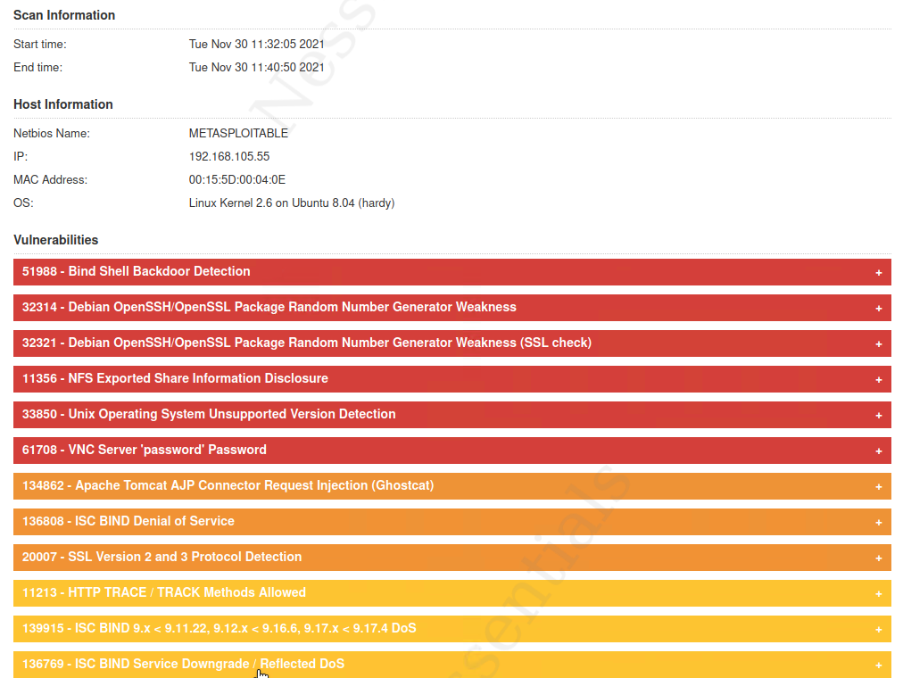
Section 5: Vulnerability Assessments
The scanner provides a vulnerability snapshot of the system in your network.

Slide 41
Project Challenges
One of the challenges I faced was doing this project was from ubuntu getting the Google authenticator working.
I was able to overcome this obstacle by doing research online to figure out the issue. When initializing google authenticator in ubuntu I was using sudo when initiating the program. I learned that you cannot use sudo in the cli when initializing for it to work properly.

Slide 42
Career Skills obtained
Working in virtual environments.
Experience with linux environments to include: Kali and Ubuntu Linux
File encryption
File shredding
Experience with hardening networks
Experience with multifactor authentication
Experience with security policies
Experience with conducting Network Security analysis

Slide 43
Conclusion
While completing this project, I have learned the importance of information security and many ways a computer network can be exploited if left unsecured.

Slide 44
REFERENCES
Kali Linux | Penetration Testing and Ethical Hacking Linux Distribution
Enterprise Open Source and Linux | Ubuntu
WireShark | Network Analyzer | Downloads, Reviews, Support
Download Nessus Vulnerability Assessment | Tenable®
Google Authenticator - Apps on Google Play

